Slide 1
Intro to VAE
Group U8: Lake Yin, Zhiqi Wang

Slide 2
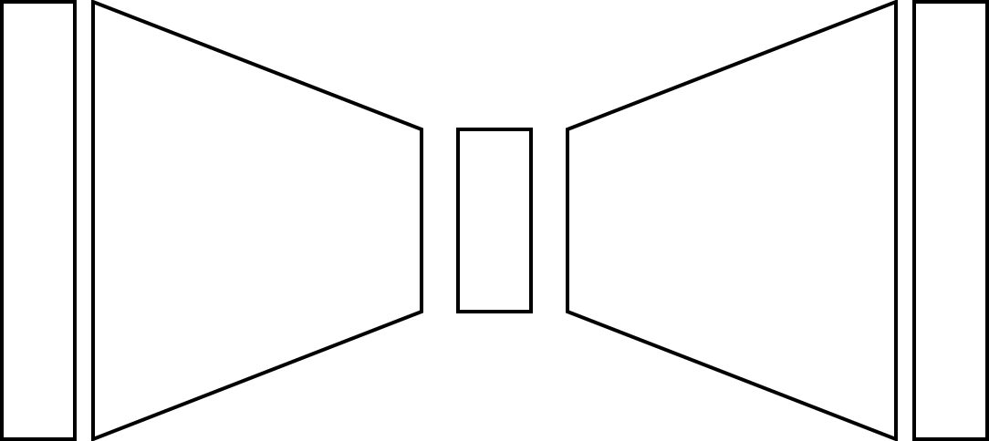




Recap on Autoencoder
$$x$$
$$\hat{x}$$
$x$is the input
$z$is latent representation of $x$ the network learns
$\hat{x}$ is the reconstruction from $x$
$$z$$
encoder
decoder

